Slide 1
Finnish Foundation for Supporting
Ex-Offenders

Slide 2
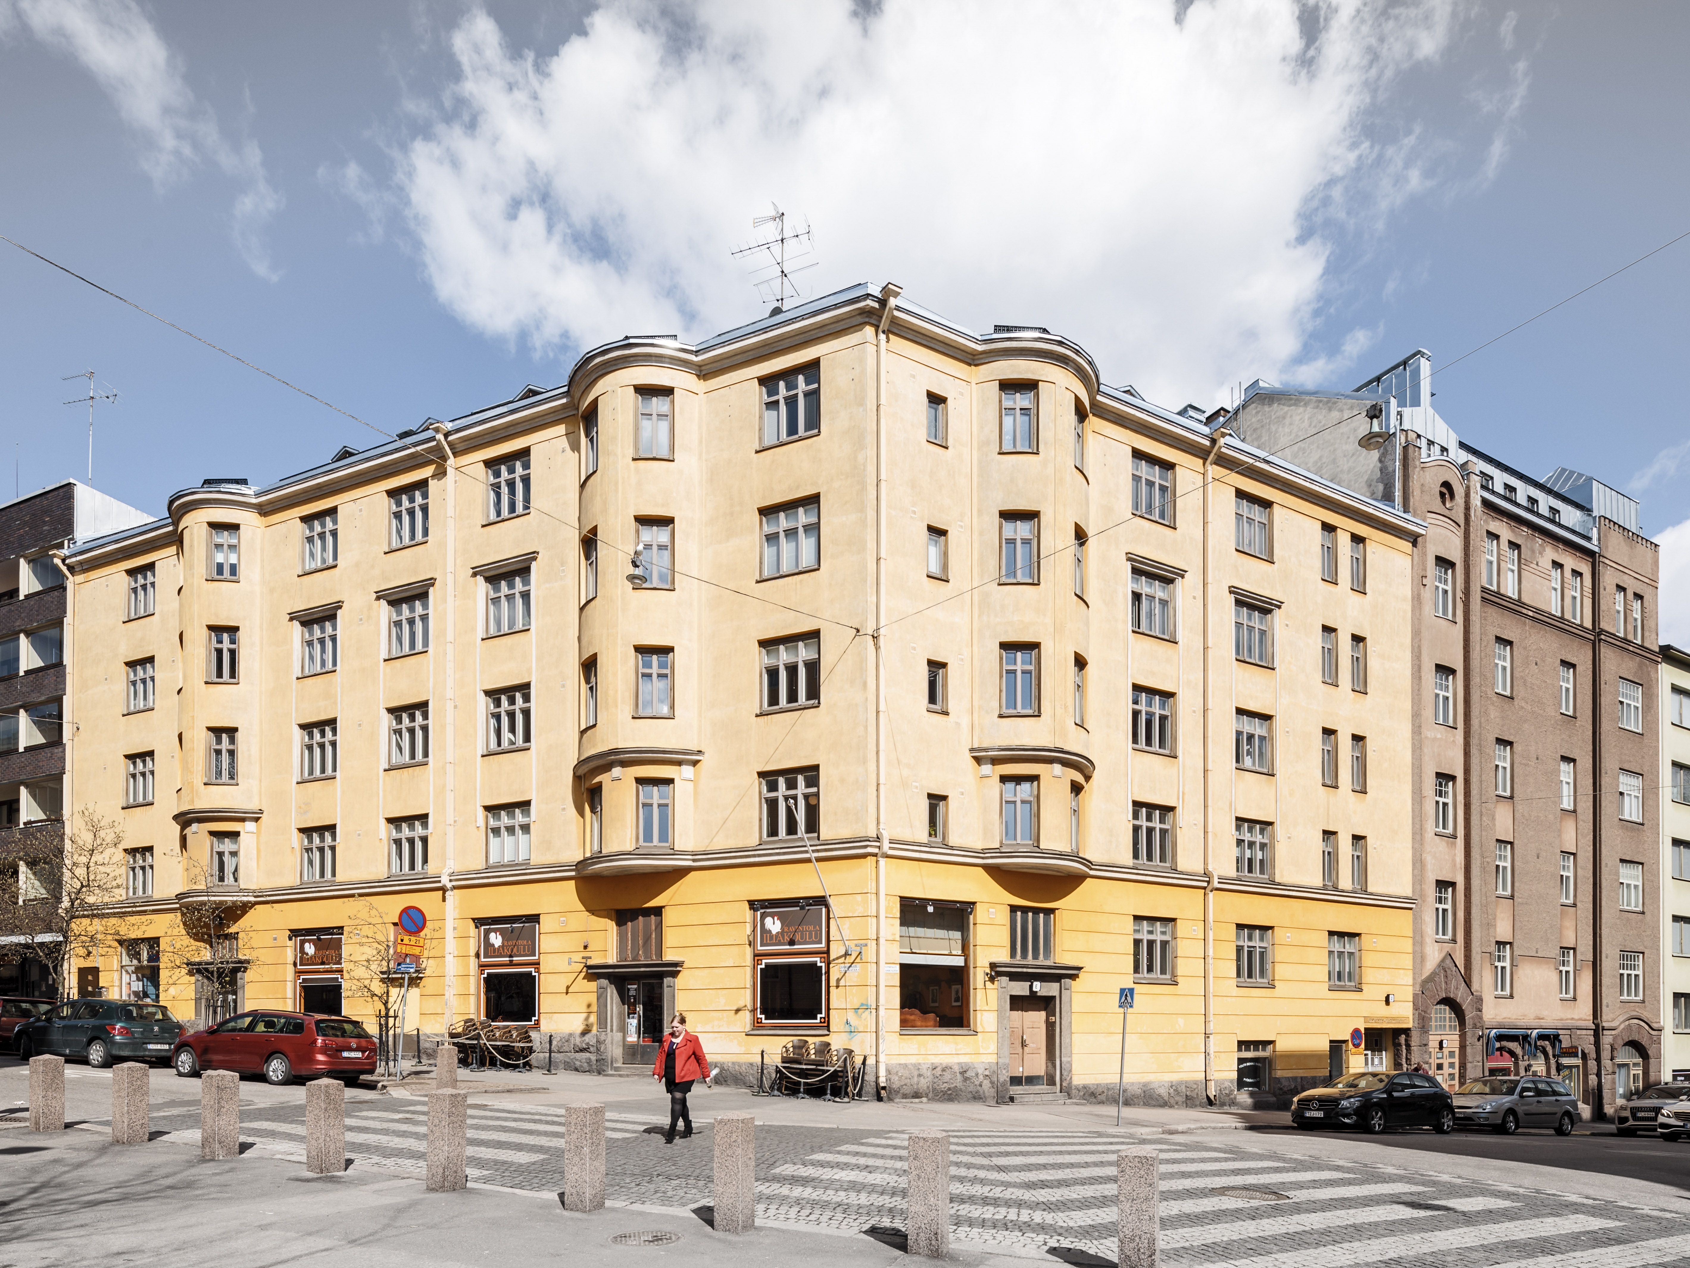
Finnish Foundation for Ex-Offenders
A non-governmental organisation (NGO) founded in 2001
Long historical roots from the 19th century
Located in Sörnäinen, near the Helsinki prison

Slide 3

Support for released offenders, people serving community sanctions, prisoners and their families
Nation-wide expertise, advocacy and service delivery

Slide 4
What we do?
Reduce re-offending and help people to positively reintegrate into society
Provide a wide range of support services (including peer support) in the community and in prisons
Distribute advice and information to clients and professionals
Coordinate four professional networks for nation-wide collaboration
Influence public debate, politics and legislation

Slide 5
OMBUDSMAN
Legal advice
ADVOCACY & DISTRIBUTING INFORMATION
HOUSING ADVICE
SUPPORTED HOUSING
COORDINATION OF NATION-WIDE NETWORKS
SUPPORT WITH LEARNING DIFFICULTIES
SUPPORTED COMMUNITY SERVICE
WHAT WE DO?
SUPPORT FOR CHILDREN & FAMILIES
MEDIATION OF SERIOUS CRIMES
DROP-IN CENTRE &
PEER SUPPORT
PREVENTION OF SEX OFFENSES
JOBS & TRAINING COL-LABORATION WITH JOKELA OPEN PRISON
YOUTH ACTION CENTE
DROP-IN CENTRE & PEER SUPPORT IN EVENINGS & WEEKENDS
SUPPORT FOR WOMEN
COMPUTER CAFE

Slide 6
Ombudsman
Defending the rights of prisoners, released offenders, those serving community sanctions and family members
Providing legal advice
Reducing stigma
Influencing legislation and criminal, social policy and health policy
Participation in working groups, committees etc.

Slide 7
Advocacy
We participate in public debates and lobby decision-makers
GOALS: social equality and criminal policy that puts a stronger emphasis on rehabilitation

Slide 8
Advocacy
Our political goals in 2019:
“Everyone deserves a home – prisoners should not be released without a home”
“Everyone has the right to education – including prisoners”
“Children have a right to parenting – prisoners’ children’s needs must be recognised”
“Treating addictions prevents re-offending – sufficient addiction treatment services must be guaranteed”

Slide 9
Thank you! https://www.krits.fi/foundation-for-supporting-ex-offenders-in-english/ https://www.krits.fi/

Slide 10
Piilotettu otsikko

